Slide 1
Twister Tuning: Optimizing Insurance Claim Handling To Minimize Costs
Karl Kreuze, Kevin Chang, Gabriel Maravilla, Brian Choi, Nicholas Nguyen

Slide 2
Abstract
Optimize insurance claim handling efficiency through quantum computing
Use superposition to minimize large cost function
Classical computers would need to exhaustively check all cases
With the increase of climate change, we need faster processing to enhance insurance claim resolution

Slide 3
Given information
Number of tornadoes of severity i in week k
Total number of tornadoes of severity i
Claims of severity i resolvable by skill j in a day
Weeks where 90% of the claims must be serviced
At least 90% of the severity i claims are serviced in the weeks where 90% must be
All claims must be serviced
Positive integers of count of workers

Slide 4
Designing the register
40 bits, 5 skill levels, 8 bits of precision for count

Slide 5
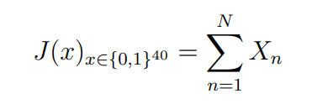
Determining the number of workers

Slide 6
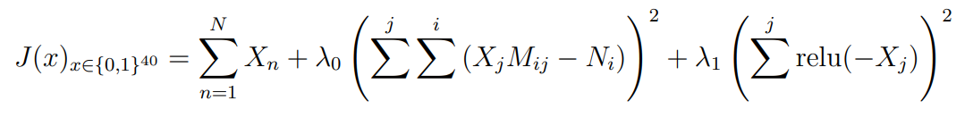
Determining the number of workers

Slide 7
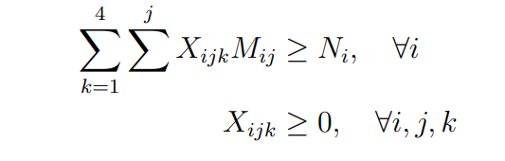
Determining the number of workers

Slide 8
Additional Constraints
Create functions to increase cost
For example, a function that compares worker skill to serviced claim virtual vs. remote
These functions can be used in prior cost evaluations or later ones

